Slide 1

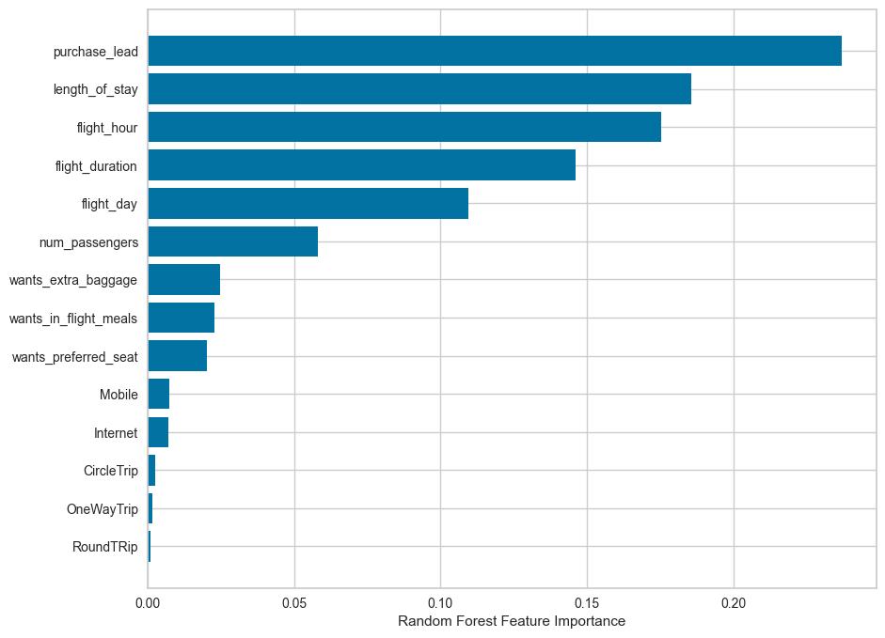
Predictive Modeling Result
01
Recall rate is 60%. Chances of predicting true booking.
02
Accuracy of model predicting unsuccessful booking is 62%
03
61% chances Will be predicted as actually completed booking out of all successfully complete booking.
Top Features that drives succesful bookings.

